Slide 1
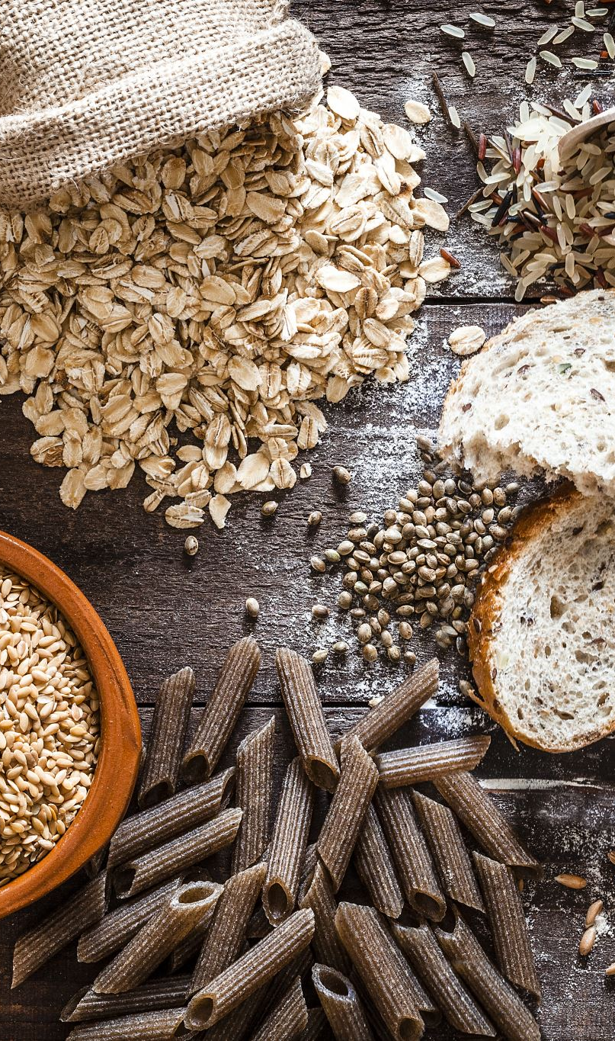
Ingredient Mass Regression from Nutritional Information
Team GAN
Andy Golebiewski
Nash Hearn
Eric Loux
Trevor Miles
Chandler Stewart

Slide 2
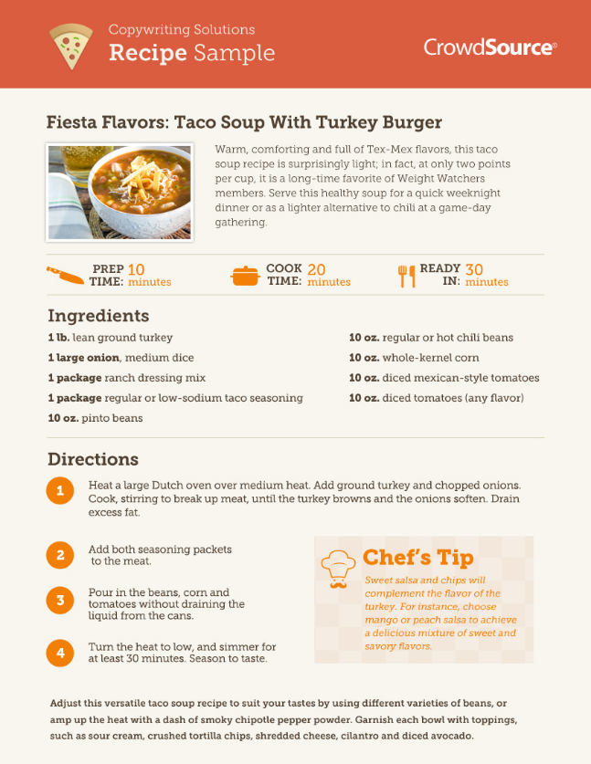
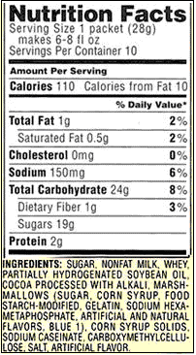
Project Overview
Background
Goal
Limitations/Assumptions
Nutritional Information
Ingredient Order
Nutritional Information
Ingredient Order

Slide 3
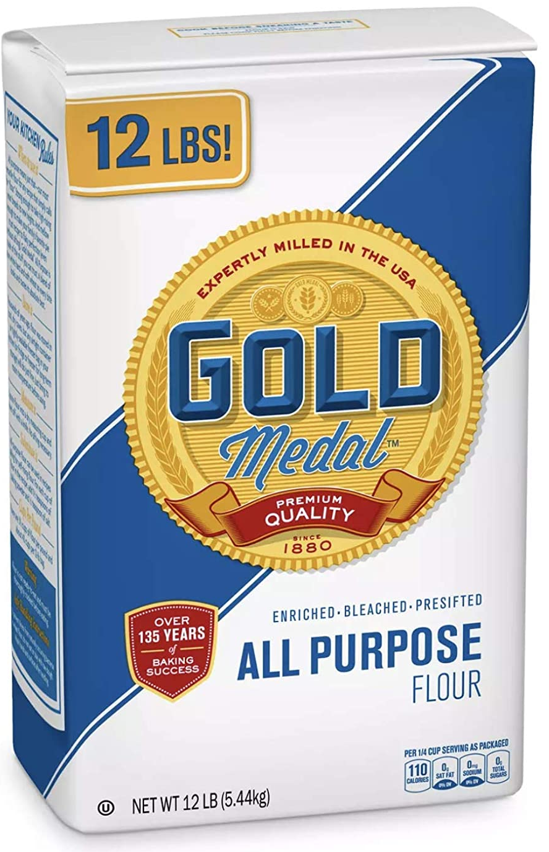
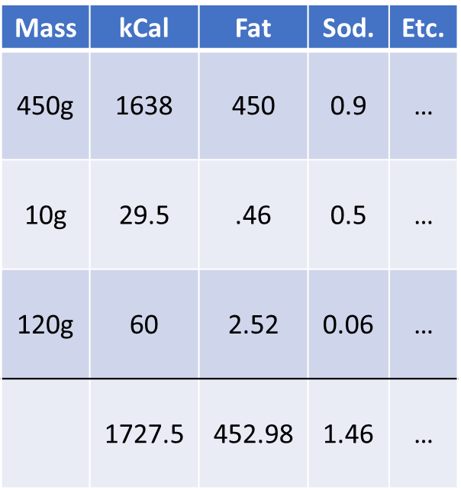
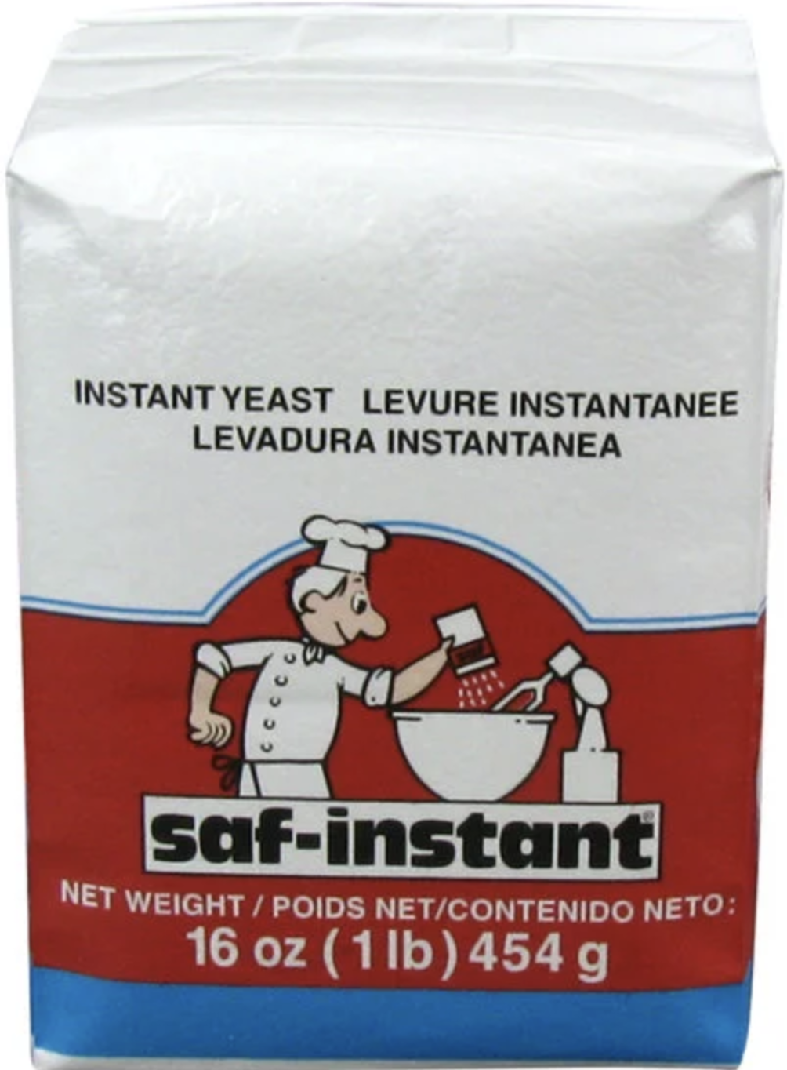
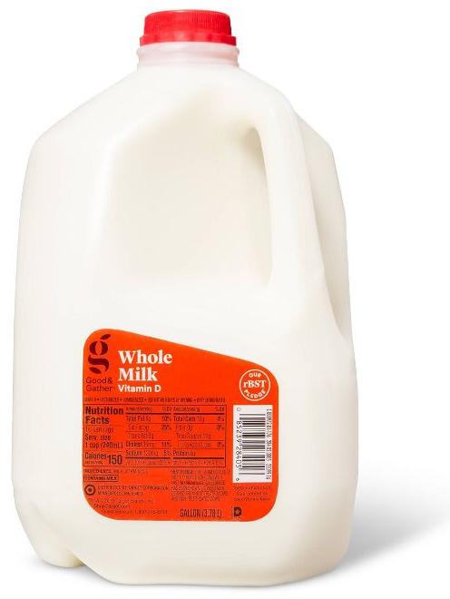
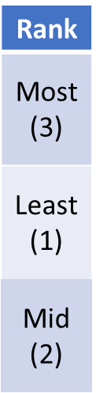
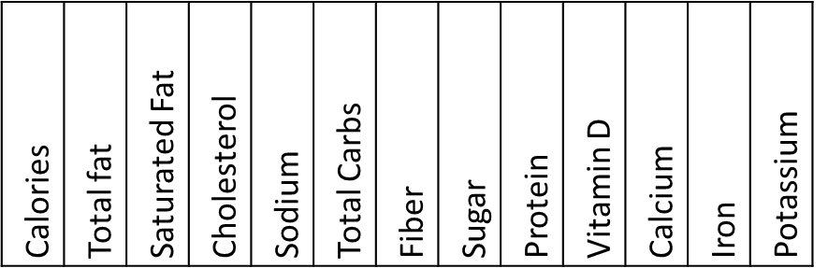
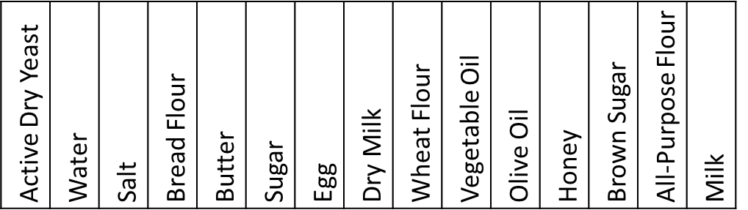
Project Architecture
13
Recipe Generator
0
Nutrition Calculator
Ingredient Ordinalizer
14
Nutritional Information
Ingredient Order
Nutritional Information
Ordinal Ingredient List
Neural Network
Ingredient Quantities
1 0 0 0 0 0 0 0 0 0 0 0 0 3 2

Slide 4
Data Sourcing
Generate “bready” recipes
Scaling based on amount of yeast
Transcribed 12 real recipes for validation
Yeast
Liquid
Flour
Sweet
Lipid
Salt
Egg
Dry Milk
15g
Bread
Flour
60%
None
20%
None
25%
Water
80%
Sugar
20%
Butter
25%
Yes
90%
All Purp.
Flour
30%
Brown
Sugar
10%
V. Oil
25%
Both
(10%)
Yes
20%
O. Oil
25%
Yes
10%
2.5g
Wheat
Flour
10%
Milk
(10%)
Honey
10%
Notes:
As a team we identify the ingredients and nutritional values most vital across various bread recipes.
- Using this base ingredient list, we can generate our own range of recipes. Voila! Now we have data to work with.
- Ingredients/Nutrients chosen based on how frequent it appeared in recipes.

Slide 5
Neural Network Component
Deep residual network
MSE (Regression)
Include loss graph here
Notes:
With a regression problem we need to assess accuracy based on loss.

Slide 6

Individual Contributions
Notes:
Add during meeting

Slide 7
Demo
link

